Slide 1
json2puml
Make data visible and understandable
Jens Fudickar, April 2022

Slide 2
API’s and DATA
Working with API’s leads to working with JSON data
A typical answer of a TMF call can look like this:
How to visualize / understand this ?
{"id": "600000000000004510", "href": "https://party/v4/individual/600000000000004510", "createdOn": "2022-01-19T13:59:03Z", "lastModifiedOn": "2022-01-19T13:59:03Z", "givenName": "Karl", "familyName": "Maier", "fullName": "KarlMaier", "birthDate": "1963-06-01T00:00:00Z", "status": "Active", "contactMedium": [{"id": "600000000000004510_ContactMedium_2", "mediumType": "postalAddress", "preferred": true,"validFor": {"startDateTime": "2022-01-17T00:00:00Z"},"characteristic": {"contactType": "legal", "city": "Berlin", "country": "DEU", "postCode": "80993", "street1": "FrankfurterStr", "place": {"id": "GeographicAddress_3912", "@referredType": "GeographicAddress", "@type": "PlaceRef"}}},{"id": "600000000000004510_ContactMedium_20", "mediumType": "telephone", "preferred": false,"validFor": {"startDateTime": "2022-01-17T00:00:00Z"},"characteristic": {"contactType": "home", "phoneNumber": "0123457689"}},{"id": "600000000000004510_ContactMedium_60", "mediumType": "email", "preferred": true,"validFor": {"startDateTime": "2022-01-17T00:00:00Z"},"characteristic": {"contactType": "personal", "emailAddress": "jesf@gmx.de", "extensions": {"verificationStatus": "verified"}}},{"id": "600000000000004510_ContactMedium_75", "mediumType": "telephone", "preferred": true,"validFor": {"startDateTime": "2022-01-17T00:00:00Z"},"characteristic": {"contactType": "home", "phoneNumber": "0123456789"}},{"id": "600000000000004510_ContactMedium_76", "mediumType": "telephone", "preferred": true,"validFor": {"startDateTime": "2022-01-17T00:00:00Z"},"characteristic": {"contactType": "mobile", "phoneNumber": "01721234567"}}],"relatedParty": [{"id": "100000004215", "href": "https:///party/v4/relatedParty/100000004215", "name": "KarlMaier", "role": "Customer", "@type": "Customer", "@referredType": "Customer", "validFor": {"startDateTime": "2022-01-17T00:00:00Z"}}]}

Slide 3
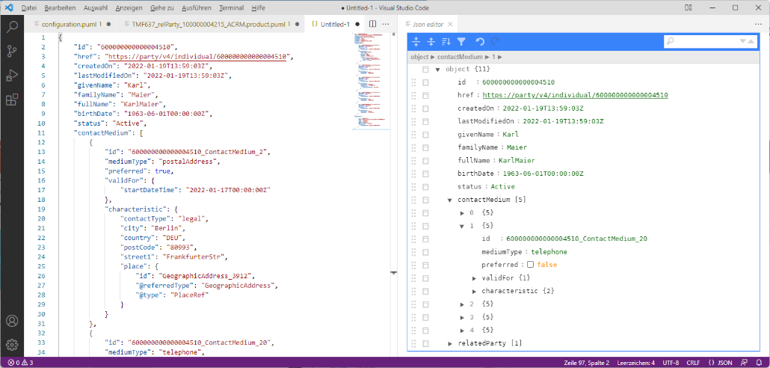
(Online) JSON Editor
This makes the live easier but it is still complex ☺

Slide 4
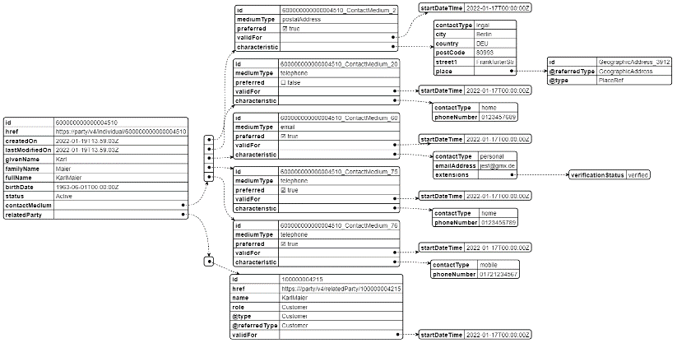
Confluence and Standard PlantUML
PlantUML supports an OOTB visualisation of JSON.
@startjson <json> @endjson
This improves also, but there is no knowledge about the data models behind

Slide 5
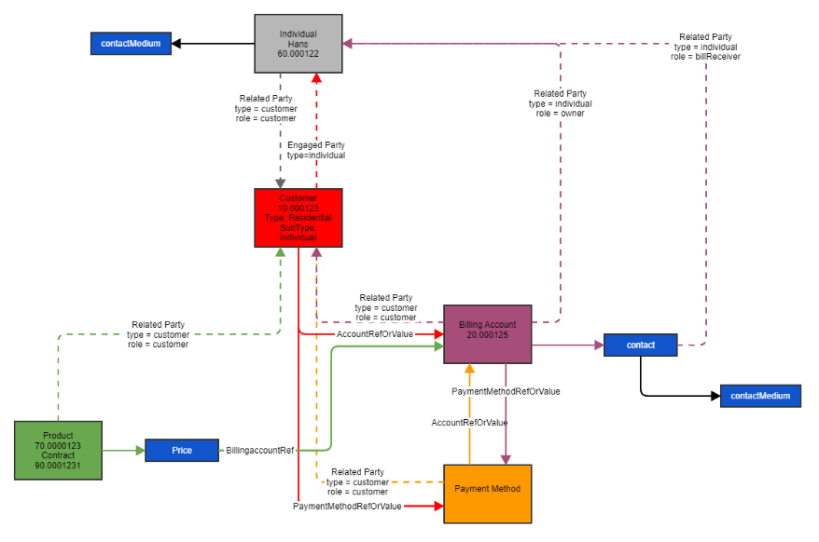
Drawing by Hand
It’s nice, and it’s giving you a task.
But it’s not effective, not accurate and not fast enough.

Slide 6
One Solution: json2puml
json2puml | is a command line tool developed to generate PlantUML files based JSON files (TMF based).
json2puml | has an understanding of how data is structured (in TMF) and simplifies and visualises the outcome.
json2puml | has the possibility to combine the JSON results of multiple API calls into one result set.
json2puml | is highly configurable to generate outcomes in different detailed levels.
json2puml | is free to use for everyone.

Slide 7
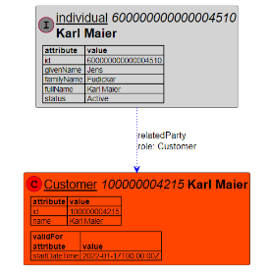
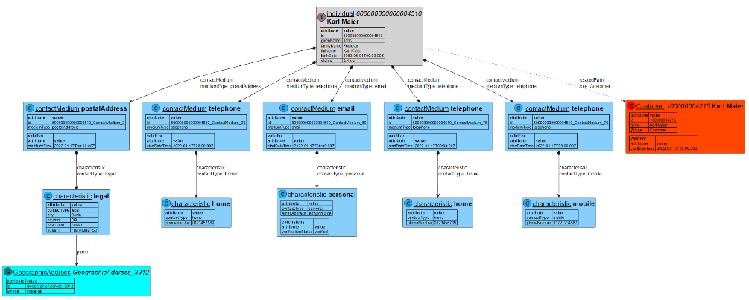
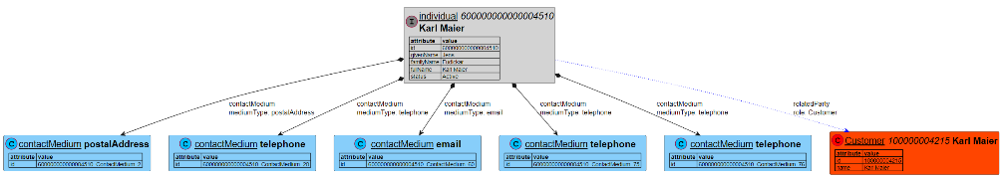
Example 1 : TMF 632 - Individual

Slide 8
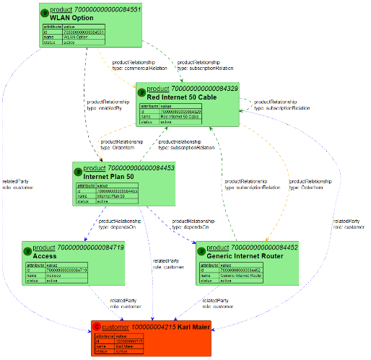
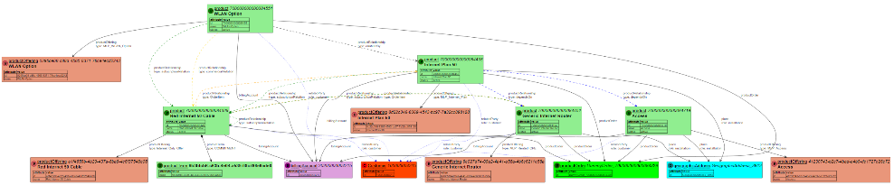
Example 2: TMF 637 – All products of a customer (different formats)

Slide 9
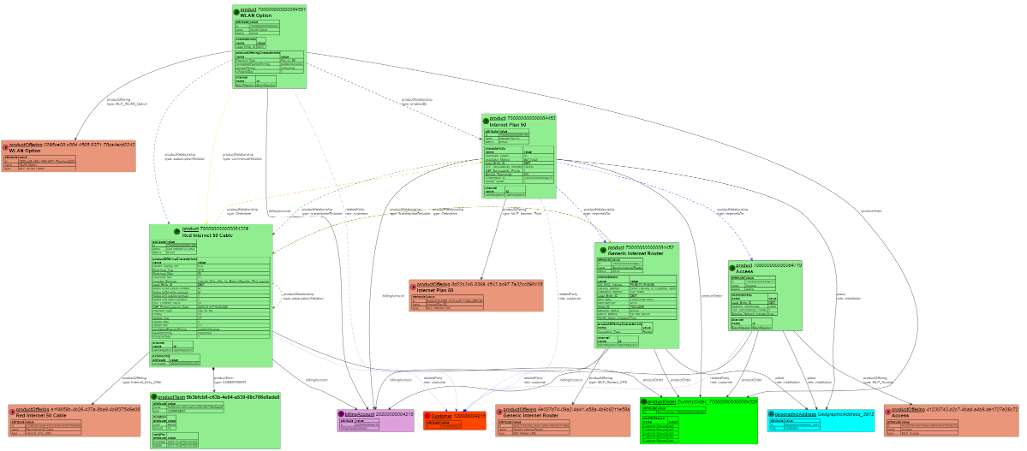
Example 2b: TMF 637 – All products of a customer

Slide 10
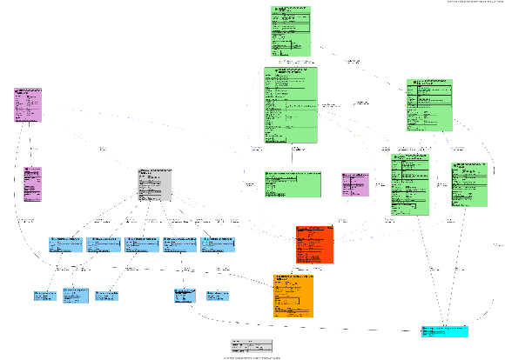
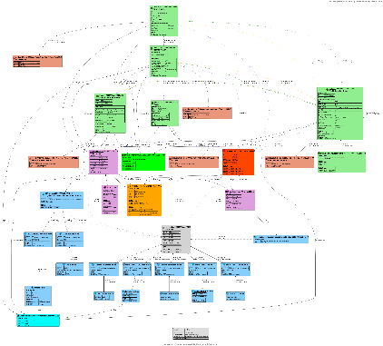
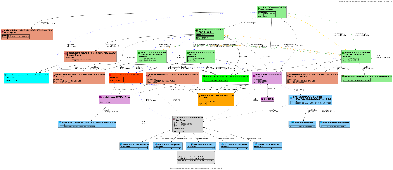
Example 3: TMF 629, 632, 637, 666, 670 for one customer (different formats)

Slide 11
Star Wars Example
SWAPI - The Star Wars API
https://swapi.dev/
What is this?
The Star Wars API, or "swapi" (Swah-pee) is the world's first quantified and programmatically-accessible data source for all the data from the Star Wars canon universe!
We've taken all the rich contextual stuff from the universe and formatted into something easier to consume with software. Then we went and stuck an API on the front so you can access it all!

Slide 12
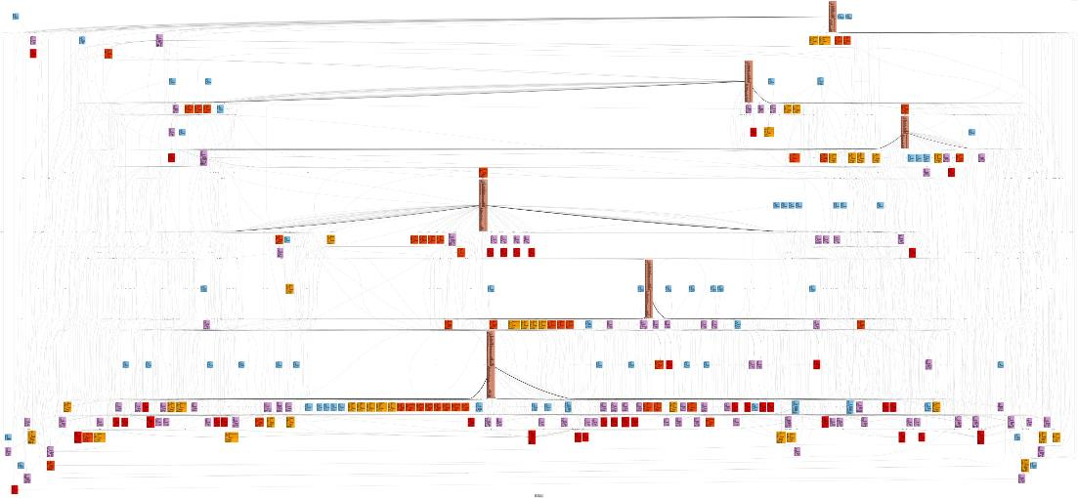
All Data 6 Films, 82 Persons, 60 Planets, 37 Species, 36 Star ships, 39 Vehicles

Slide 13
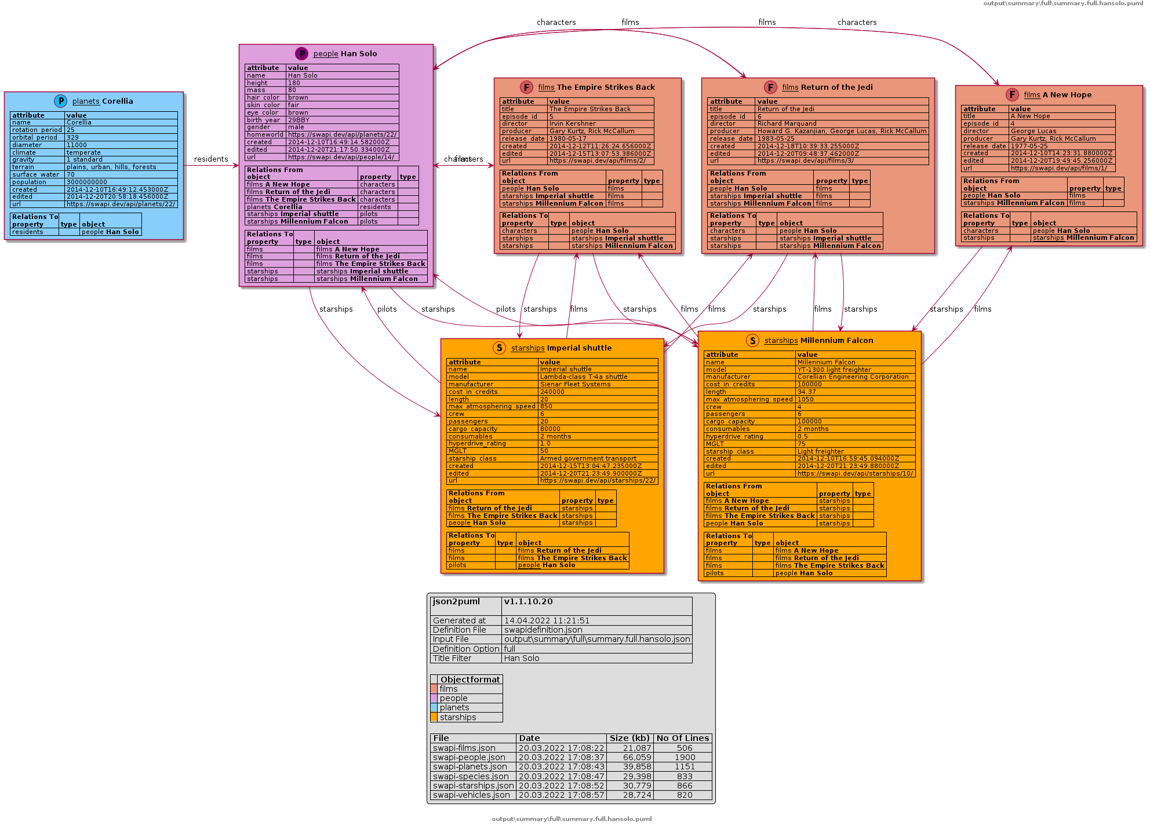
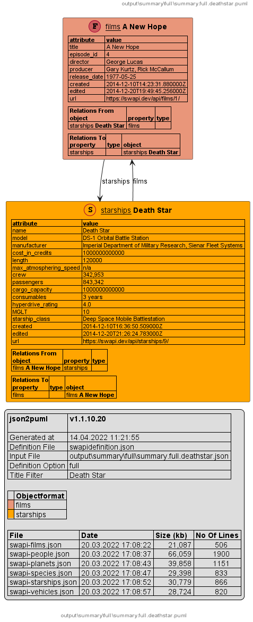
Examples
/titlefilter:“Han Solo”
/titlefilter:“Death Star”

Slide 14
Command line parameters:
json2puml TMF-Open API Command Line Converter to PUML
/? : Help screen
/plantumljar:<file> : Plantuml Jar file which should be used to generate the sample images
If defined this parameter overwrites the corresponding parameter in the definition file
/definition:<file> : Definitionfile which contains the configuration of the mapper
/optionfile:<file> : Optionfile which contains only the configuration of one option which then will be used for generation
/option:<name> : Name of the option group of the definitionfile which should be used to generate the files
/alloptions : Flag to generate for all defined options
/inputfile:<file> : Single JSON file to be migrated
/inputlistfile:<file> : Listfile which contains the coniguration to handle list of
different files to be migrated as one big file
/leadingobject:<name> : Name of the property which should be used as highest level of the json objects
This parameter is only needed for the single file conversion
/outputformat:<format> : Format of the generated Puml converters (Allowed values: png,svg,pdf)
/openoutput:[<format>] : Flag to define if the generated files should be opened after the generation.
The files will be opened using the default program to handle the file format.
Optional the files to be opended can be restricted by the format types (Allowed values: png,svg,pdf,puml)
/generatedetails:<boolean> : This allows to overwrite the generateDetails property of the inputlistfile
/generatesummary:<boolean> : This allows to overwrite the generateDetails property of the inputlistfile
/generateoutputdefinition : Flag to define if the merged generator definition should be stored in the output folder.

Slide 15
Call Examples
c:\json2puml>json2puml.exe /inputfile:data\sample2\TMF632_id_600000000000004510_ACRM.json /leadingobject:individual
json2puml v1.0.6.6 - Command line converter JSON to PUML
Current parameters:
/definitionfile: definition\json2pumldefinition.json
/inputfile: data\sample2\TMF632_id_600000000000004510_ACRM.json
/leadingobject: individual
[ 1/ 1] Convert data\sample2\output\default\summary.default.json
to data\sample2\output\default\summary.default.puml
puml generated
png generated
svg generated

Slide 16
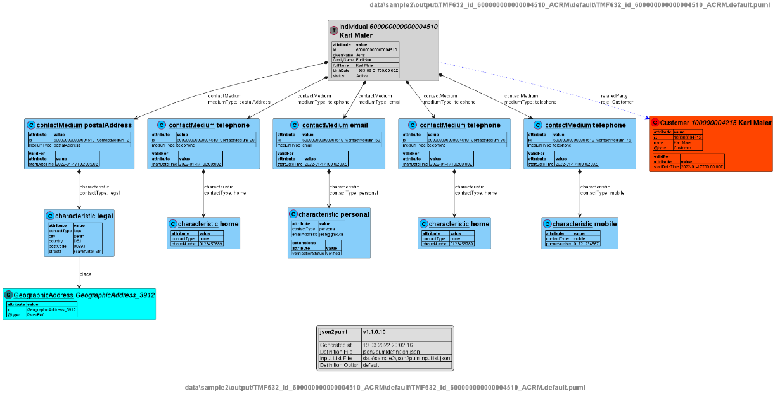
Call output

Slide 17
Where can you find it:
Vodafone MS-Teams : json2puml (currently restricted to people having a Vodafone Account)
Microsoft Teams - json2puml
Solstice Confluence :
Data Support Tool - json2puml - SOLSTICE - Vodafone DE Confluence

